Slide 1
Fundamentals of Psychology
Chapter # 1 INTRODUCTION TO PSYCHOLOGY
Sadia Qazi
Sadia.qazi@ucp.edu.pk

Slide 2
Understanding about behavior
Everyone wants to know about oneself and other people around them.
Psychology requires scientific approach
Natural settings, laboratories, schools, colleges, universities, parks, markets, organizations……. Every social setting.
Study about HOW, WHAT and WHY of human behavior.

Slide 3
Defining Psychology
Psychology…………..
Psyche (soul/mind)
Logy (study)

Slide 4
Definition of Psychology
Psychology is the “scientific study of mental processes and behavior”.
It encompasses not just what people do but also their thoughts, emotions, perceptions, reasoning processes, memories, and even the biological activities that maintain bodily functioning.
Scientific study
Mental processes
Behavior

Slide 5
Goals of psychology
To Describe
The first goal of psychology is to describe how humans and animals behave in different situations. Through continued observation we can define what kind of behavior is considered normal or healthy and what may be seemed as abnormal or unhealthy.
To Explain
Why does this behavior occur? Under what circumstances will it occur again? In order to explain a behavior, psychologists must conduct experiments to ensure that the behavior is not an anomaly. They have to consider which factors trigger certain behavior, as well as formulate certain theories which will help explain the same.

Slide 6
Goals of psychology
Predict
Making predictions based on how people previously thought and acted is one of the primary goals of social psychology. By analyzing past observed behavior, psychological studies aim to predict and anticipate how a certain behavior will appear again in the future. This allows psychologists to form a pattern of behavior and better understand the underlying causes of people’s actions.
Control
Aside from treating mental illnesses and enhancing well-being, changing or controlling human behavior is one of the primary goals of research in psychology (“How the goals of psychology," n.d.). Various psychological studies about human behavior are used to influence, change, or control behavior using previously gathered data about human behavior.

Slide 7
Example
Someone did something that they weren't supposed to do that had a negative impact on their life. You want to try to help/solve the problem and naturally, the following questions might run through your mind:
"What happened?" (describing),
"Why did she do that?" (explaining),
"What would happen if she did this?" (predicting)
"What can she do next time to have a different outcome?" (changing).
The main difference between us asking these questions and psychologists and professional mental health professionals asking these questions is that there is a high level of education and training in the explaining, predicting and changing process that facilitates lasting positive change for individuals.

Slide 8
hISTORY OF PSYCHOLOGY
Psychological perspectives
Structuralism – understanding the conscious experience through introspection.
Wilhelm Wundt
Functionalism – focused on how mental activities helped an organism adapt to its environment.
William James
Psychodynamic – focuses on the role of the unconscious in affecting conscious behavior.
Sigmund Freud
Gestalt Psychology – Focuses on humans as a whole rather than individual parts.
Wertheimer, Koffka, Kohler
Behaviorism – focuses on observing and controlling behavior.
Pavlov, Watson, Skinner
Humanism - emphasizes the potential for good that is innate to all humans.
Abraham Maslow and Carl Rogers
Biological
Cognitive
Sociocultural

Slide 9
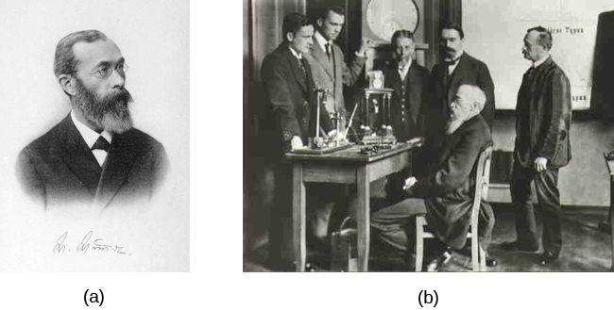
Structuralism (WILHELM WUNDT ) Focus: The structure of consciousness — breaking mental processes into their smallest parts (sensations, thoughts, feelings). Method: Introspection → trained participants reported their conscious experiences while being exposed to stimuli. Example: Looking at a rose and describing sensations (color, smell, texture). Criticism: Highly subjective, not scientific enough.
Wilhelm Wundt is credited as one of the founders of psychology. He created the first laboratory for psychological research.
Wundt emphasized structuralism. He focused on understanding the structure and characteristics of the mind through introspection.
Introspection - Process by which someone examines their own conscious experience in an attempt to break it into its component parts

Slide 10
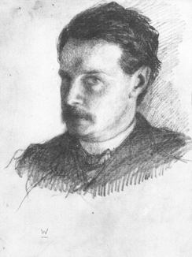
Functionalism (WILLIAM JAMES )
William James, shown here in a self-portrait, was the first American psychologist.
James drew from the functionality of cognitive processes, establishing functionalism.
Functionalism - emphasized how mental activities contributed to basic environmental survival.
Focus: The function of mental processes, how consciousness helps humans adapt to their environment.
Belief: The mind is like a "toolbox" for survival.
Methods: More practical than structuralism , used observation, experimentation.
Legacy: Opened the door to applied psychology (education, workplace psychology).

Slide 11
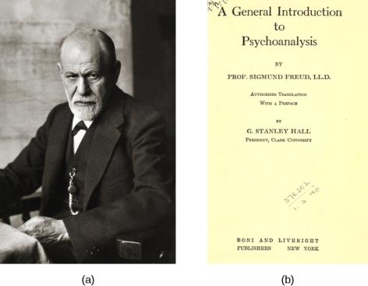
Psychodynamic (SIGMUND FREUD)
Focus: The unconscious mind — hidden desires, fears, and conflicts influence behavior.
Key Concepts: Id, Ego, Superego; defense mechanisms; psychosexual stages of development.
Method: Dream analysis, free association, talk therapy.
Legacy: Inspired modern psychotherapy, though criticized for lack of scientific rigor.
Sigmund Freud was a highly influential figure in the history of psychology.
One of his many books, A General Introduction to Psychoanalysis, shared his ideas about psychoanalytical therapy; it was published in 1922.

Slide 12
SIGMUND FREUD (psychoanalytic theory)
Founded Psychoanalytic theory, a perspective which dominated clinical psychology for many decades.
Studied “hysteria” and neurosis.
Theorized that many of his patients’ problems arose from the unconscious mind.
Believed that one way the unconscious mind could be accessed was through dream analysis.
Psychoanalytic theory focuses on the role of a person’s unconscious and early childhood experiences.
Freud’s Couch (credit: BBC)

Slide 13
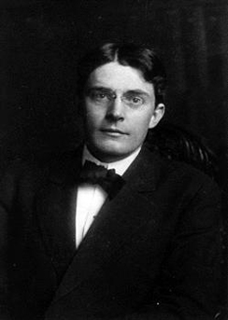
BEHAVIORISM (John b.Watson)
John B. Watson is known as the father of behaviorism within psychology.
Believed that objective analysis of the mind was impossible.
Instead he focused on observable behavior and ways to bring that behavior under control.
Today, behaviorism is used in behavioral and cognitive-behavioral therapy.

Slide 14
IVAN PAVLOV (CLASSICAL CONDITIONING)
Founders: John B. Watson, later B.F. Skinner.
Focus: Observable behavior only (not thoughts/feelings).
Belief: Behavior is shaped by the environment through conditioning.
Key Experiments:
Pavlov’s Dogs → Classical Conditioning.
Watson’s Little Albert → Conditioning fear.
Skinner’s Box → Operant Conditioning (rewards & punishments).
Legacy: Behavior therapy, educational psychology, applied behavior analysis.

Slide 15
IVAN PAVLOV (CLASSICAL CONDITIONING)
Discovered the concept of classical conditioning.
Studied conditioned reflexes in which an animal produced a reflex (unconscious) response to a stimulus (salivating in the presence of food) and, over time, was conditioned to produce the response to a different stimulus (salivating to the sound of a bell) that the experimenter associated with the original stimulus (Food and bell became associated).
(Credit: Emaze)

Slide 16
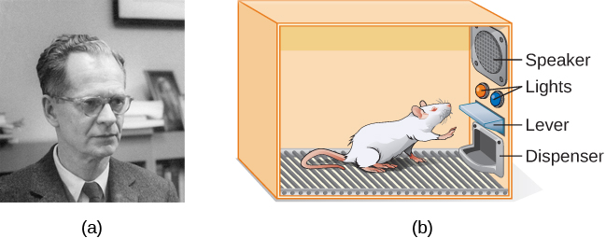
B. F. Skinner
Concentrated on how behavior was affected by its consequences.
Studied the principles of modifying behavior through reinforcement and punishment which he saw as major factors in driving behavior (operant conditioning).

Slide 17
Key Figures: Carl Rogers, Abraham Maslow.
Focus: Free will, personal growth, and human potential.
Belief: Humans are inherently good and strive for self-actualization (becoming the best version of themselves).
Applications: Client-centered therapy, positive psychology.
Contrast: Seen as a response to behaviorism (too mechanical) and psychoanalysis (too negative).
Humanism (CARL ROGERS )

Slide 18
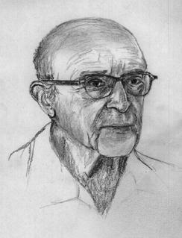
Humanism (CARL ROGERS )
Carl Rogers developed a client-centered therapy method that has been influential in clinical settings.
Client-centered therapy involves the patient taking a lead role in the therapy session.
Rogers believed therapists need:
unconditional positive regard
genuineness
Empathy
(credit: "Didius"/Wikimedia Commons)

Slide 19
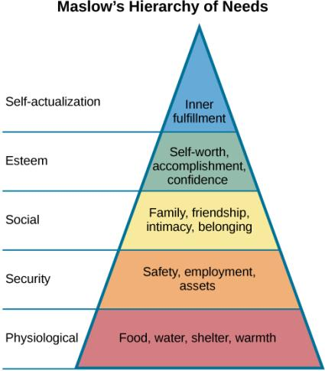
Humanism (ABRAHAM MASLOW)
Proposed a hierarchy of human needs in motivating behavior.
Maslow asserted that so long as basic needs necessary for survival were met (e.g., food, water, shelter), higher-level needs (e.g., social needs) would begin to motivate behavior.

Slide 20
Modern Perspectives in Psychology Biological Approach
Focus: Links between biology and psychology.
Key Assumptions:
Thoughts and emotions come from brain processes.
Genes and heredity influence behavior.
Hormones and neurotransmitters play a role.
Methods: Brain imaging (fMRI, PET), genetic studies, neuroscience.
Example: Studying serotonin’s role in depression.
Application: Medical treatments for mental disorders (medication, brain stimulation).

Slide 21
Modern Perspectives in Psychology
Cognitive Approach (1950s–present)
Focus: Internal mental processes — thinking, memory, problem-solving, decision-making.
Key Assumptions:
The mind works like a computer (information processing).
Mental processes can be studied scientifically.
Key Figures: Jean Piaget (cognitive development), Aaron Beck (cognitive theory of depression).
Applications: Cognitive-Behavioral Therapy (CBT).Research on memory, attention, learning. Links to artificial intelligence

Slide 22
Modern Perspectives in Psychology Sociocultural Approach (1960s–present)
Focus: The influence of society, culture, and social interactions on behavior.
Key Assumptions:
Behavior can’t be understood without context.
Cultural norms, values, gender roles, ethnicity shape psychology.
Key Figures: Lev Vygotsky (social development theory), Albert Bandura (social learning theory).
Examples: Cross-cultural studies on individualism vs. collectivism. Research on conformity (Asch), obedience (Milgram).
Application: Multicultural psychology, diversity in therapy, social justice studies.

Slide 23
Difference between Psychologist and Psychiatrist
Psychologist:
Focus extensively on psychotherapy and treating emotional and mental suffering in patients with behavioral intervention.
Psychologists obtain PsyD doctoral degree, Throughout their education, psychologists study personality development, the history of psychological problems and the science of psychological research.
Psychiatrist:
They are trained medical doctors, they can prescribe medications, and they spend much of their time with patients on medication management as a course of treatment.
Psychiatrists attend medical school and are trained in general medicine. After earning an MD, they practice four years of residency training in psychiatry.

Slide 24
Sub fields of psychology
1. Clinical Psychology
Clinical psychology is the branch of psychology concerned with diagnosing and treating mental, emotional, and behavioral disorders. Clinical psychologists use a variety of methods including psychotherapy, psychological testing, and research to promote mental health (Kazdin, 2008).
2. Cognitive Psychology
Cognitive psychology focuses on internal mental processes such as perception, memory, learning, problem-solving, and decision-making. It views humans as active processors of information (Neisser, 1967).

Slide 25
Sub fields of psychology
3. Educational Psychology
Educational psychology is the study of how humans learn in educational settings, the effectiveness of teaching methods, and the psychology of instruction. It also examines differences in learner characteristics and development (Ormrod, 2012).
4. Environmental Psychology
Environmental psychology examines the interaction between humans and their physical surroundings, including built and natural environments, and how these influence behavior and well-being (Gifford, 2007).

Slide 26
Sub fields of psychology
5. Forensic Psychology
Forensic psychology applies psychological principles to legal issues, including assessment of offenders, competency evaluations, jury decision-making, and providing expert testimony (Bartol & Bartol, 2018).
6. Health Psychology
Health psychology studies how biological, psychological, and social factors influence health, illness, and health care. It emphasizes prevention, health promotion, and coping with illness (Taylor, 2009).

Slide 27
Sub fields of psychology
7. Industrial/Organizational (I/O) Psychology
I/O psychology applies psychological theories and research to the workplace. It focuses on employee behavior, performance, motivation, leadership, and organizational effectiveness (Muchinsky, 2006).
8. Consumer Psychology
Consumer psychology explores how people select, purchase, use, and dispose of products, services, ideas, and experiences. It investigates the psychological and social influences on consumer decision-making (Schiffman & Kanuk, 2007).

